Slide 1
Long Island Population Health Improvement Project (LIPHIP)
March 17, 2016

Slide 2
LI Cares Healthy Food Donation Drive
Thank you!

Slide 3
Communications
Social Media Solicitation
Facebook.com/LiHealthCollaborative
Weekly Event Blasts

Slide 4
LIHC Member Presentation
Presentation on Collaboration: Prevention Agenda and Community Health Rankings, Albany NY- March 2016

Slide 5
Anne K. Thorsen, Community Executive 631-300-3166 or anne.Thorsen@cancer.org Gabrielle Andrea, Health Systems Manager, Hospitals 631-300-3168 or gabrielle.andrea@cancer.org
American Cancer Society
Reviewed January 2016

Slide 8
LIHC/PHIP Updates
Academic Partners
PHIP Public Health Intern Academic Project
Survey Deadline Extension- April 11, 2016

Slide 9
LIHC/PHIP Updates
Working Documents
Strategic Plan-Draft

Slide 10
LIHC/PHIP Updates
Public Education, Outreach & Community Engagement (PECE)
Website re-launch-Consumer Facing Pages
Physician Mailing
Parks RX Program
National Walking Day-April 6, 2016
Promotional Resource Gathering Survey

Slide 11
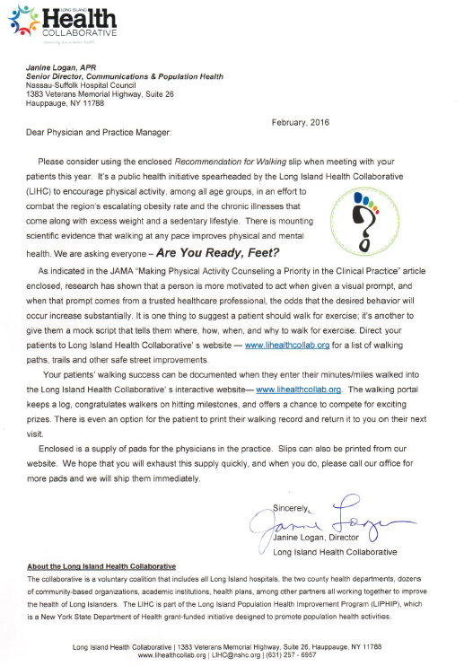
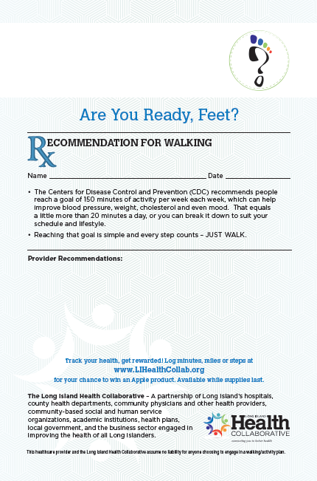

Slide 12
Association for Mental Health & Wellness: First Aid Training
Report from Participants

Slide 13
LIHC/PHIP Updates
Culturally and Linguistically Appropriate Services – CLAS Train the Trainer Sessions
Alignment with Nassau-Queens PPS and Suffolk Care Collaborative

Slide 14
Data Updates
Wellness Portal: Complementary Training Session
PQI Data for Hospitals
MapInfo
Vital Statistics

Slide 15
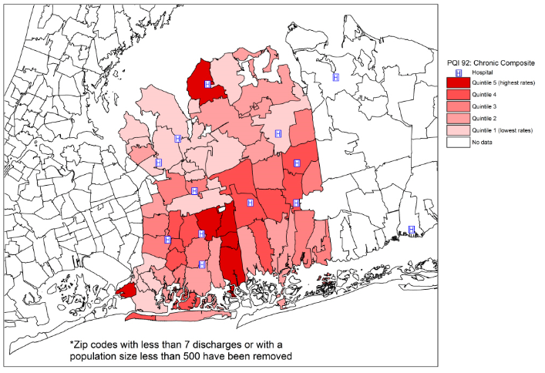
PQI 92: Nassau County

Slide 16
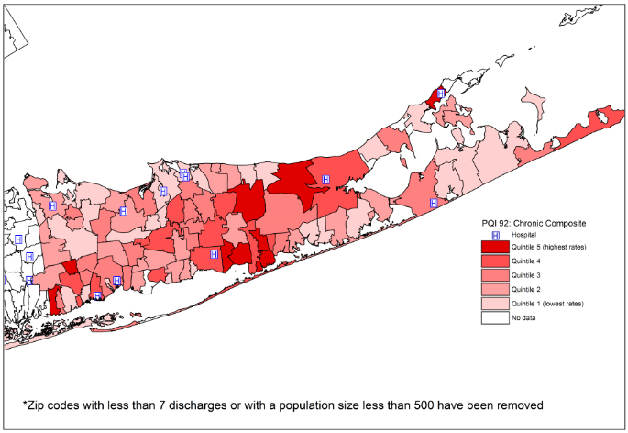
PQI 92: Suffolk County

Slide 17
PHIP Workgroups
Public Education Outreach and Community Engagement
Academic Partners
Data Analysis
Nutrition and Wellness/Complete Streets
PHIP-led workgroups:
CLAS/Workforce
Industry Partners

Slide 18
Community Needs Assessments
Prevention Agenda Survey for Community Members
Report on Data Analysis: March 30, 2016
Please return paper surveys to Nassau-Suffolk Hospital Council immediately
Zip Code level analysis

Slide 19
CBO Summit Event Update
Nassau County CBO Summit Event –Adelphi University 2/2/16
Suffolk County CBO Summit Event- St. Joseph’s College 2/10/16
Qualitative Data Analysis and Final Reports

Slide 20
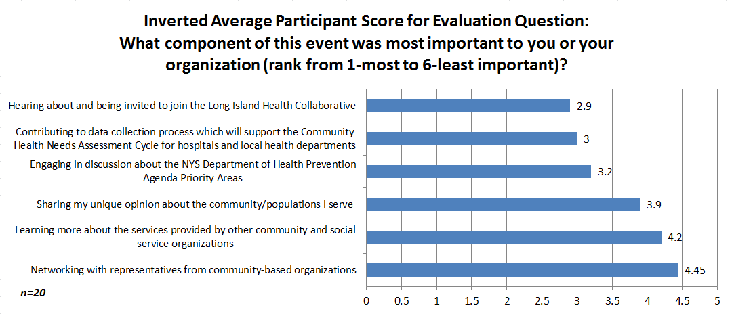
Nassau Event 2-2-16 Adelphi

Slide 21
Nassau Event Feedback
Aside from the options provided in question 3, were there any OTHER event components that were important to you or your organization? | Please provide any feedback (positive or negative) about the event.
Enhancing the role/partnership of local government with Nassau county CBOs | I found the event to be very well-planned and organized. I was able to share and learn a great deal of important information in a short time frame.
Bringing senior and caregiver issues to the table | I love learning about other organizations and connecting with them, but I didn't feel I had opportunity to do that outside of my table
learning about the outstanding barriers to health care access | I thought it was well put together and executed. I thought the fact that we were able to "voice" our own experiences based on who we service was excellent and needed.
The opportunity for collaboration on issues of nutrition and health | I was thrilled to be involved in such a comprehensive event.
 | I enjoyed it thoroughly and I felt like a part of a bigger initiative to combat similar health issues and barriers we see within our community. It was great.

Slide 22
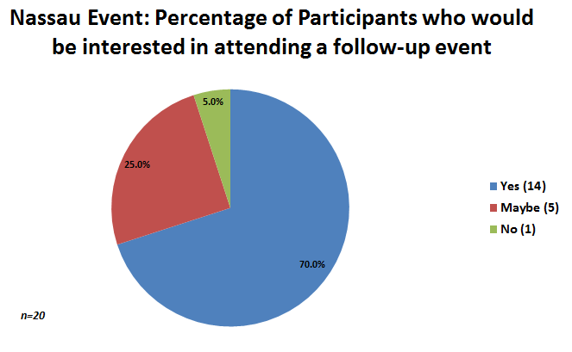
Nassau Event Feedback
Suggestions for Improvement:
Environmental acoustics
Increased focus on senior care issues
More opportunity/time to network around the room
Of 20 total participant responses, there were 18 reported connections made among Community-Based Organizations as a result of attending the event.

Slide 23
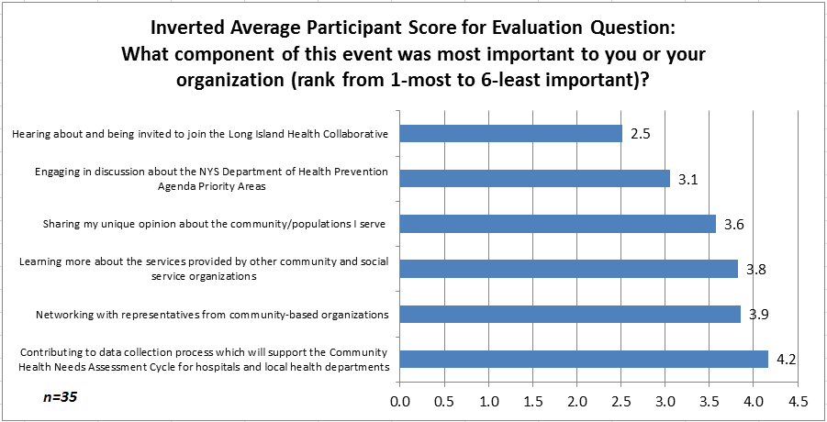
Suffolk Event 2-10-16 St. Josephs

Slide 24
Suffolk Event Feedback
Aside from the options provided in question 3, were there any OTHER event components that were important to you or your organization? | Please provide any feedback (positive or negative) about the event.
understanding the ins and outs of other organizations | I had wished our discussions could have progressed and unfolded, without such a time constraint... maybe another half hour would have been beneficial.
non-profits agencies collaborating (not competing) | It is important to have the opportunity to connect in common cause, especially because services here are so "silo-ed." Understanding the needs and clearly defining the problems is a huge step, but we need to really do something to address the problem. I think this initiative shows a really promising start, but I really hope it leads us to action.
Understanding the initiatives being brought to the communities | I appreciated the stenographer; knowing that what was being said has the chance of really being heard by people who maybe could make a difference in these matters.
Learning of the health needs, as currently perceived, in the community | I liked the table discussion - it was a comprehensive way to get a lot of opinions on the same subject quickly.
discussing the intersection of different issues and populations | Wonderful opportunity to share information and concerns with other CBO representatives.
feeling re-energized that we can, in fact, make a difference

Slide 25
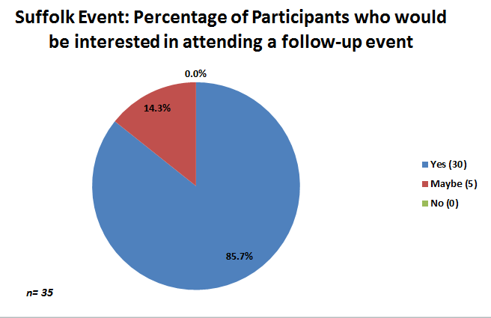
Suffolk Event Feedback
Suggestions for Improvement:
Environmental acoustics
Request for more opportunity/time to network around the room
Concern regarding transcription recording
Of 35 total participant responses, there were 69 reported connections made among Community-Based Organizations as a result of attending the event.

Slide 26
Walk With Ease Program Arthritis Foundation
Evidence-based program
EAC Inc. partnership with YMCA in Glen Cove
Nassau County Organizations

Slide 27
Population Health Improvement Program Updates
State Budget Update
NSHC Board Meeting, March 7, 2016
Briefing for Legislators, March 11, 2016

Slide 28
Questions/Feedback?

Slide 29
Upcoming Meetings
April 20, 2016 2:30-4:30pm
May 18, 2016 9:30-11:30am
June 16, 2016 9:30-11:30am

